Slide 1
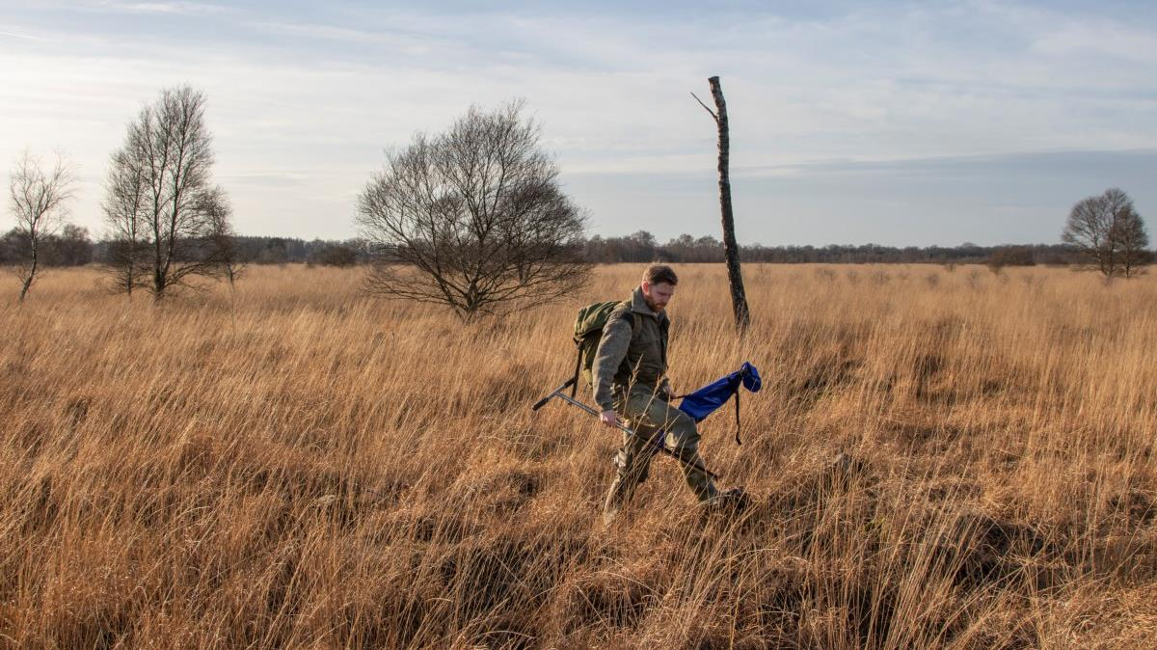
Welcome @ De Peel
Notes:
Titelpagina variant 1.1 bedoeld als startpagina van je presentatie

Slide 2

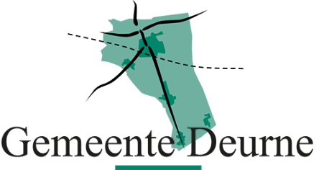


Partners
Notes:
Titelpagina variant 2.2 bedoeld als startpagina van je presentatie

Slide 3
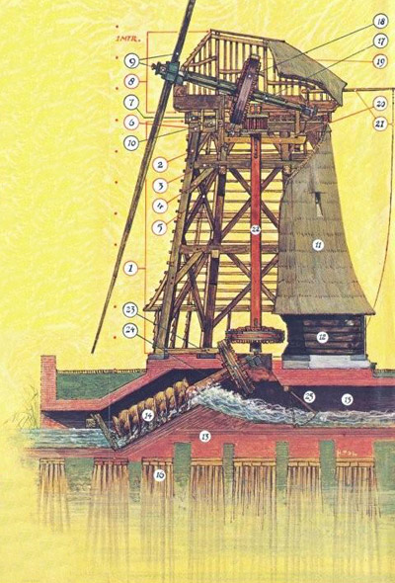
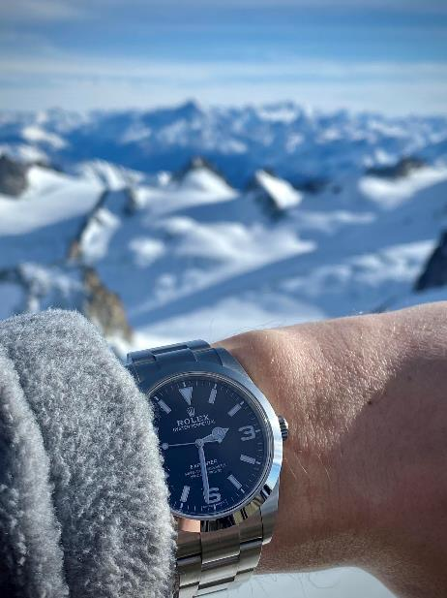
Notes:
Hoofdstukaanduiding. Startpagina nieuw onderwerp versie 1.1

Slide 4
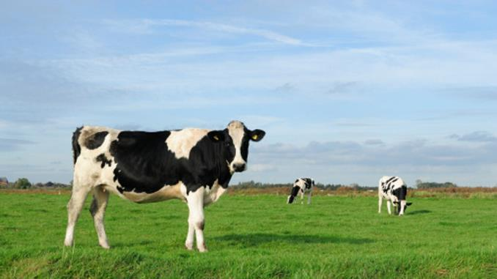
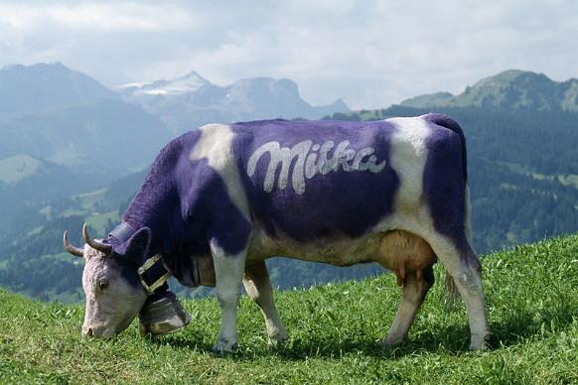
Notes:
Hoofdstukaanduiding. Startpagina nieuw onderwerp versie 1.1

Slide 5
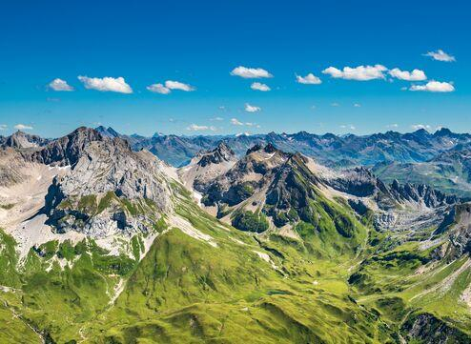
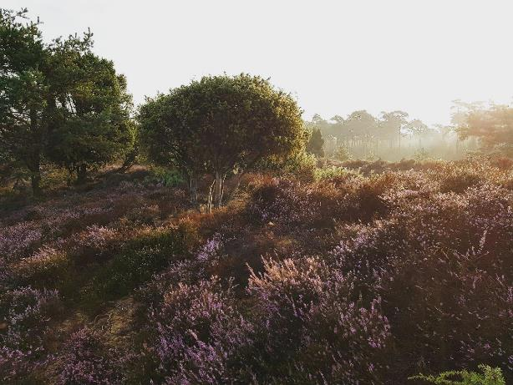
Notes:
Hoofdstukaanduiding. Startpagina nieuw onderwerp versie 1.1

Slide 6
9.00 Welcome
      Staatsbosbeheer - Nature conservation in the Netherlands
      Water Board Aa en Maas - Water management in the area
      Municipality Deurne - The diversity of assignments in the region
11.00 Break
      Province Noord-Brabant
      Funding and planning of nature conservation in the province of Brabant
      Amt für Landschaft und Natur, Kanton Zürich
      Introduction
      Discussion with Hagar Royackers and Freek Rebel
      How to improve nature with all other tasks in the region?
12.00 Lunch
13.00 Field visit
      Leegveld How an agricultural area is turned into nature with room for recreation
      Break and transport
      Demonstration zone The restauration of rare raised bogs
16.00 End
Program
Notes:
Titelpagina variant 2.1 bedoeld als startpagina van je presentatie

Slide 7
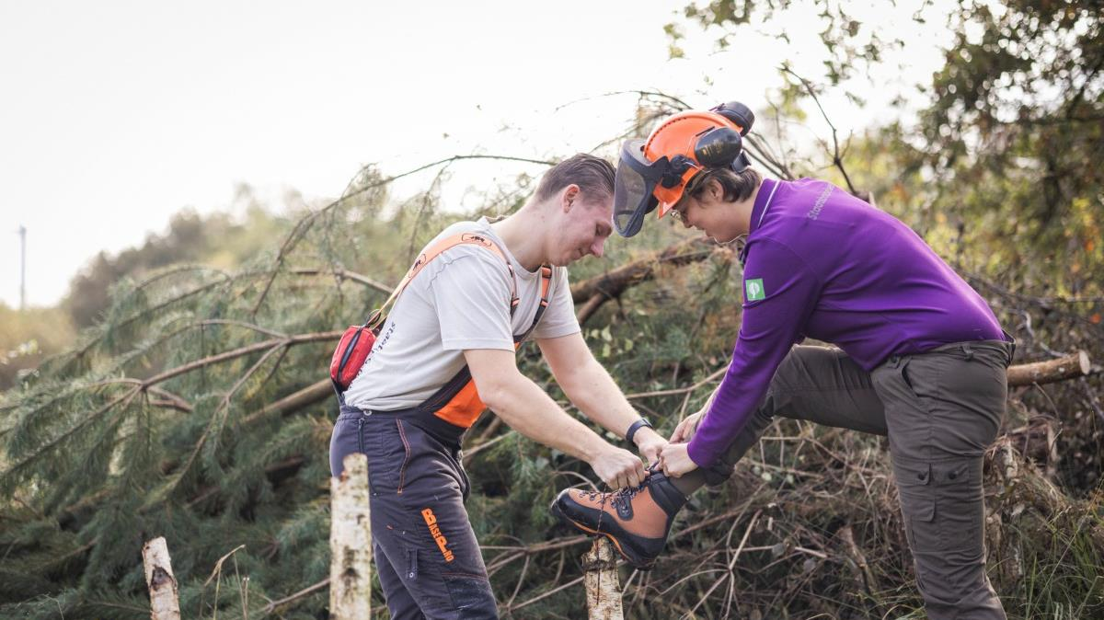
English, Dutch, German…
Notes:
Titelpagina variant 2.2 bedoeld als startpagina van je presentatie

Slide 8
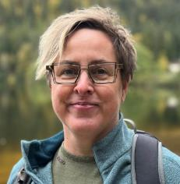
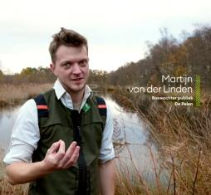
Logistics
Your hosts: Mathilde Klaasse Martijn van der Linden
Photo and video recordings during the day (in your own language)
Website: https://www.staatsbosbeheer.nl/naturschutzswitzerland (until 31/12)
Questions? Ask!
IT IS HOT – sunscreen and waterbottles
Notes:
Titelpagina variant 2.2 bedoeld als startpagina van je presentatie

Slide 9
Comparison
Switzerland Netherlands
Acreage 41,2 km2 41,5 km2
Inhabitants 8,9 million 17,8 million
Population density 215/km2 533/km2
% nature 31% 15%
% protected 24% 26%
% agricultural 19% 45%
Public roads 84.000 km 142.000 km (25% is cycling)
Highest peak 4634 m (Dufourspitze) 322,4 m (Vaalserberg)

Slide 10
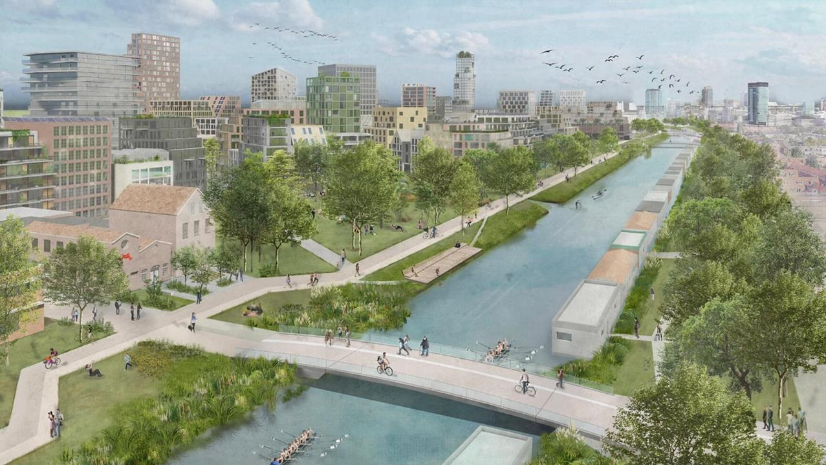
A challenge!

Slide 11
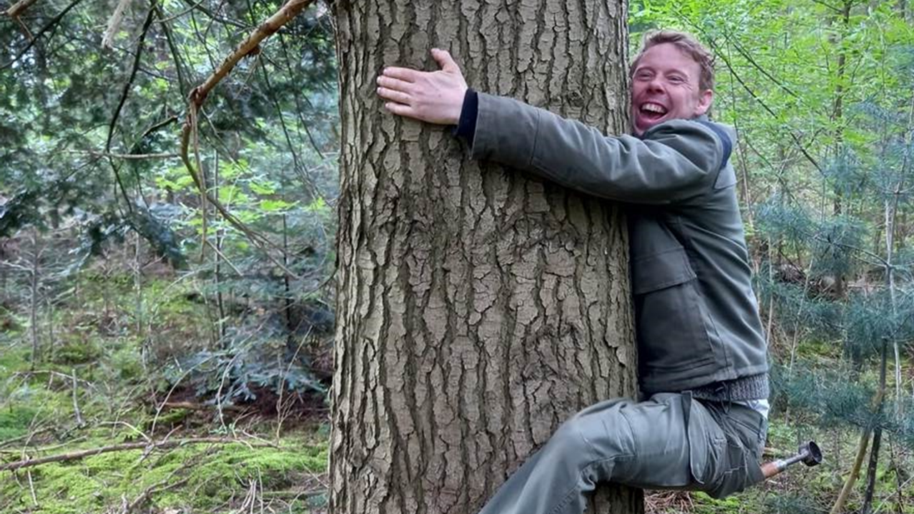
Who are we?
Notes:
Titelpagina variant 1.1 bedoeld als startpagina van je presentatie

Slide 12
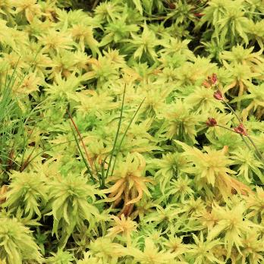
Where are we?
Head quarters: Amersfoort
Notes:
Overzichtspagina. Gele pointer verplaatsen naar de locatie die je uit wilt lichten. De gele pointer kan makkelijk worden gekopieerd zodat je meerdere plekken op de kaart aan kunt wijzen

Slide 13
Organisation
Founded in 1899
We are a legal entity with a statutory task (RWT): managing and sustainably bringing the entrusted areas to social benefit. Staatsbosbeheer is accountable to the Ministry of Agriculture, Fisheries, Food Security and Nature (LVVN) for its objectives and budget.
Staatsbosbeheer manages the green heritage of the Netherlands; 268.000 hectares of nature and 1.900 objects
3 features:
  beschermen – protect – schützen
  beleven – experience - erfahren
  benutten – sustainable use – nutzen
1400 employees, 8000 volunteers and a lot of social jobs (including 400 through Binnenwerk)

Slide 14
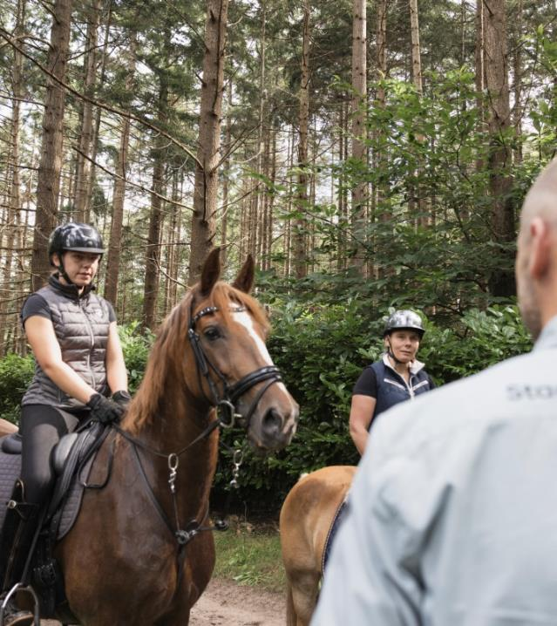
Very busy…
150 million visitors annually
4.000 km of hiking paths
2.500 km of cycle paths
2.000 km of riding trails
9 Visitorcenters; 1 million visits/year
70 campgrounds
56 holiday cottages

Slide 15
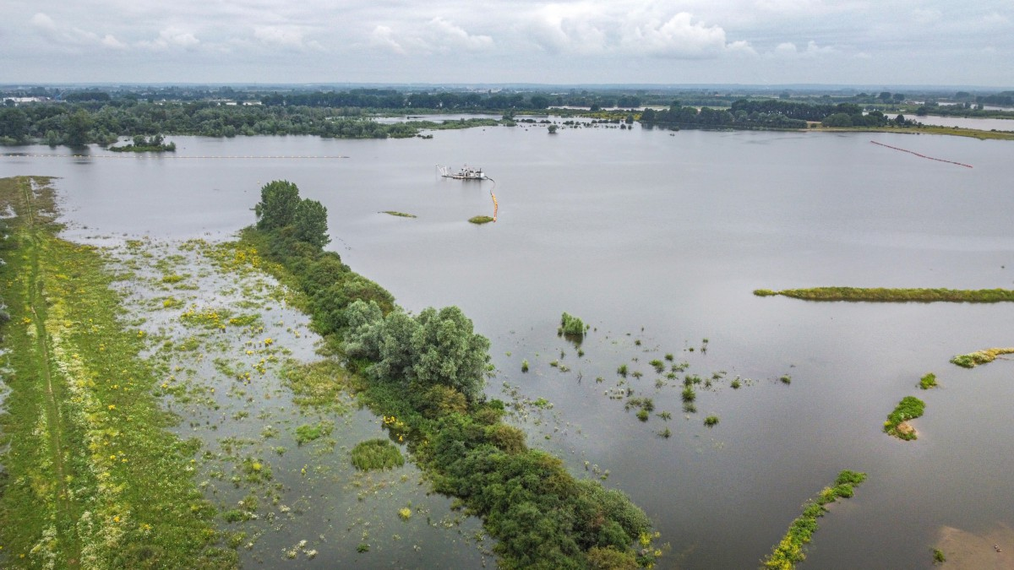
Owner and manager of significant landscapes – river valleys

Slide 16
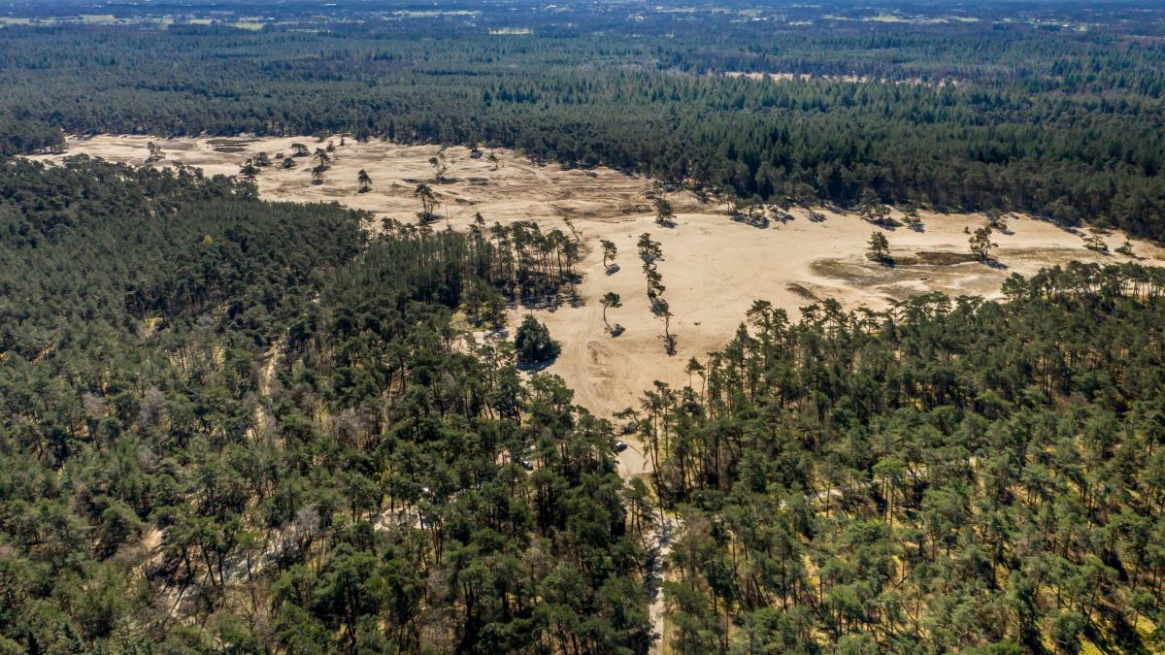
Owner and manager of significant landscapes – drifting sand

Slide 17
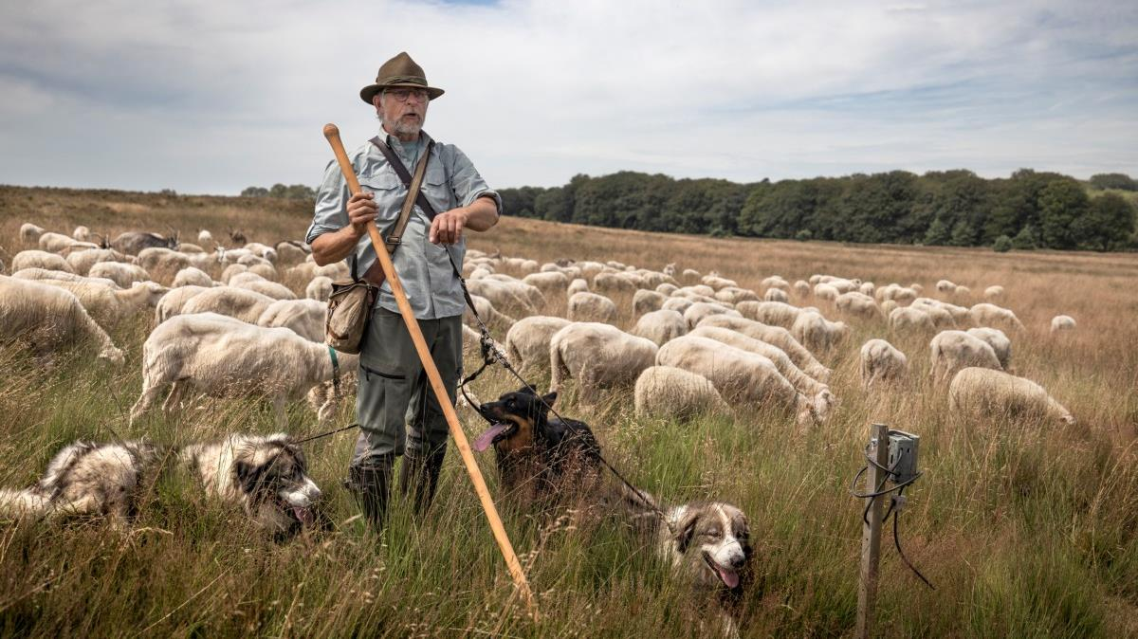
Owner and manager of significant landscapes – heath

Slide 18
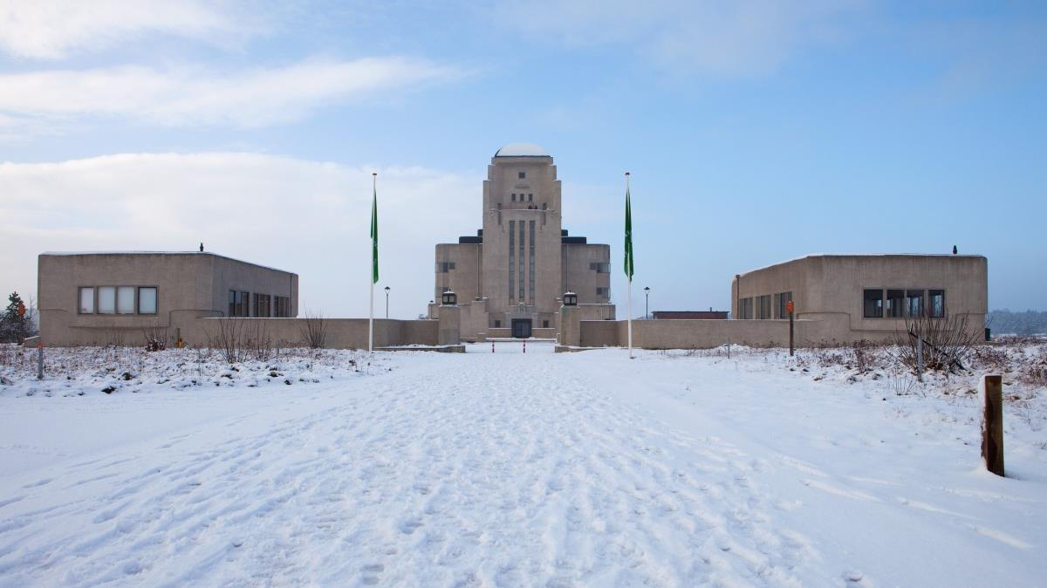
Owner of significant buildings –
Radio Kootwijk

Slide 19
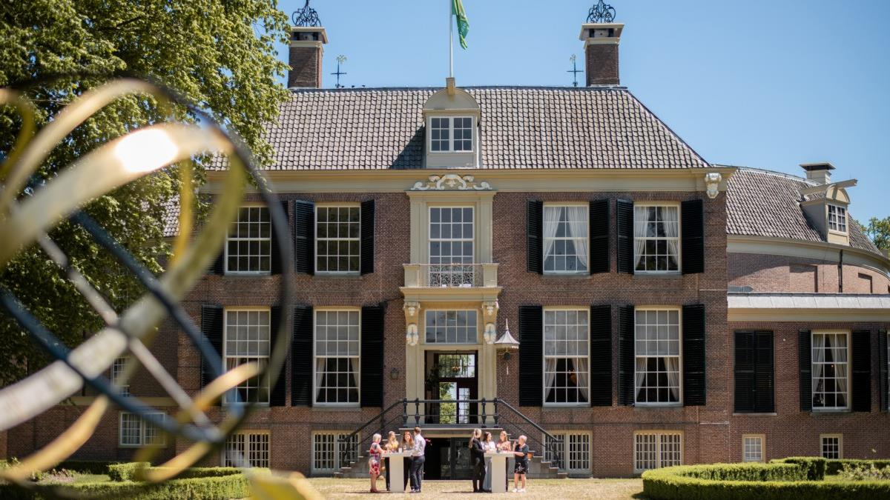
Owner of significant buildings –
Kasteel Groeneveld

Slide 20
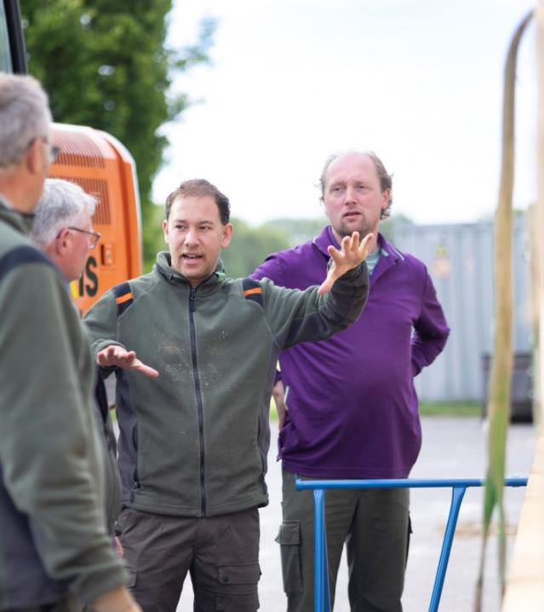
Different specialties,
different views
Conservation
Ecology
Recreation
Government
Municipalities
Waterboards
Farmers
Citizens

Slide 21
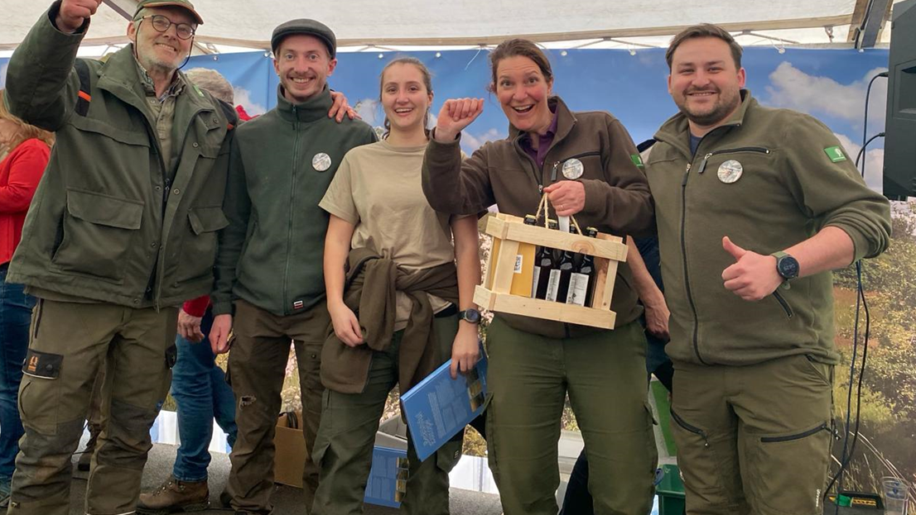
Together ☺
Notes:
Titelpagina variant 1.3 bedoeld als startpagina van je presentatie

Slide 22
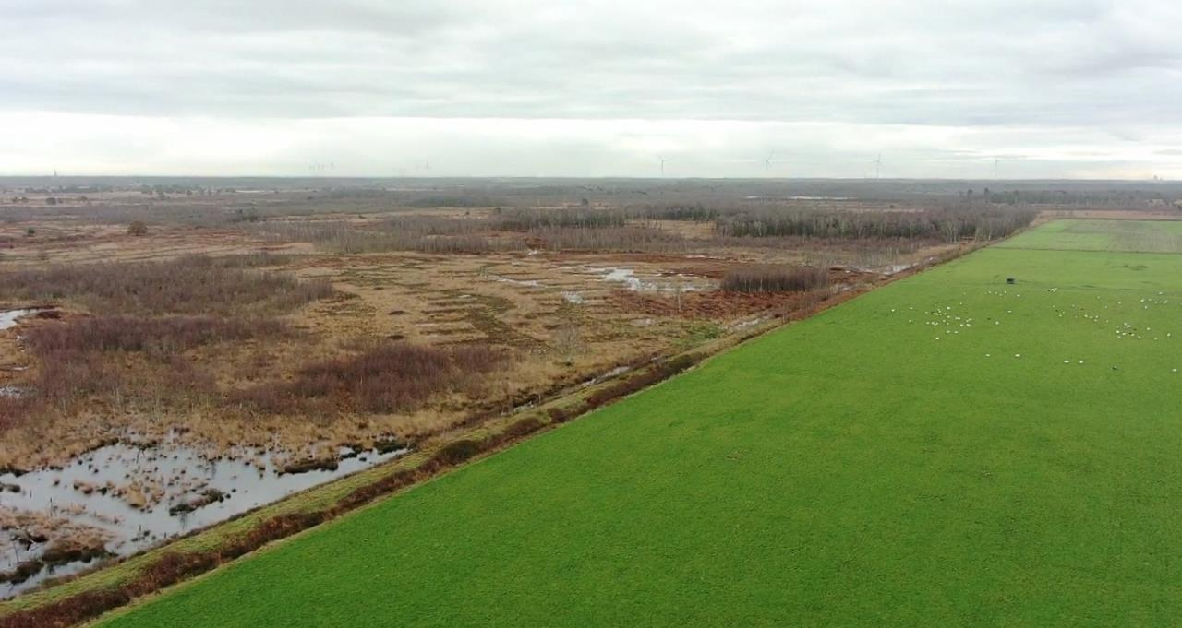
An introduction to the watersystem around the Peel
Geert Dekker (gdekker@aaenmaas.nl)

Slide 23
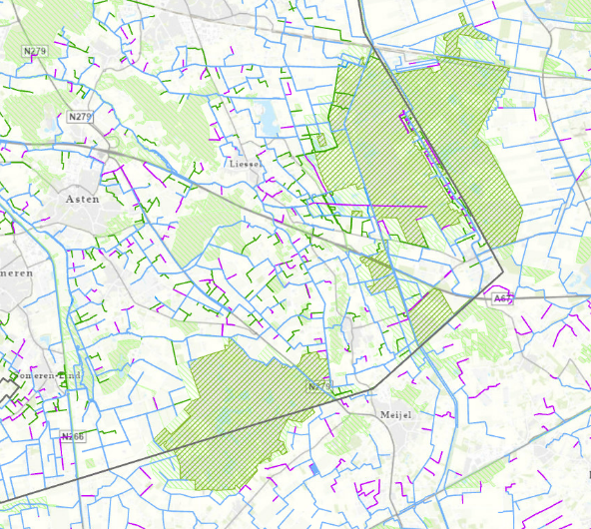
Introduction
The waterboard manages the regional watersystem in the Netherlands (dykes, wastewater, irrigation, drainage, …)
Mission: watersafety, droughtprevention, and clean water.

Slide 24
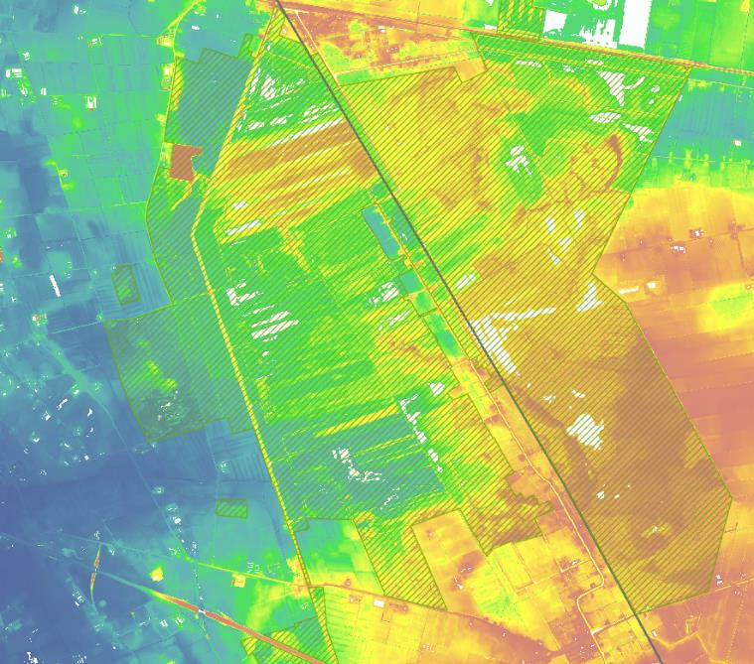
Elevation map
Because the Peel is a raised bog system, it sits a little higher than the agricultural land around it.
How to keep water on a “mountain”?

Slide 25
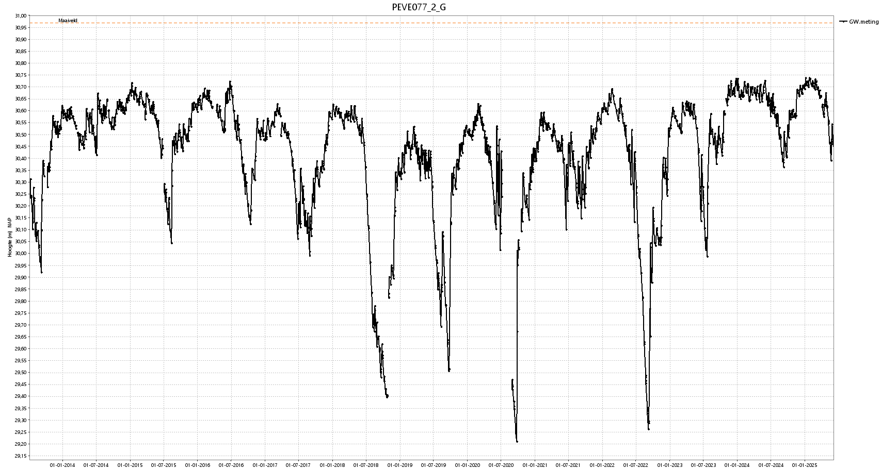
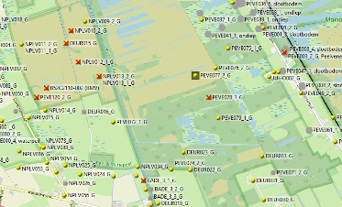
The problem: how to limit groundwaterfluctuation?
Optimum is 35 cm fluctuation!

Slide 26
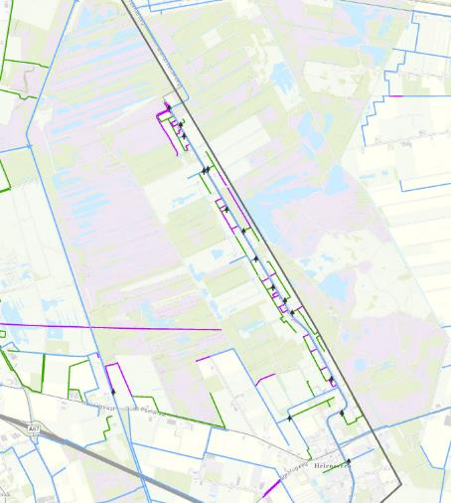
Around the Peel
Focus on keeping water inside the Peel, and keeping the area outside the Peel dry enough for agriculture or housing. Quite a tight balance…
Small weirs to capture rainfall
Standstill policy for drainage and irrigation from groundwater
Irrigation network using the old canals
Buffers (such as Leegveld)
Little pumps (polder) to keep houses dry (the houses are cultural heritage)

Slide 27
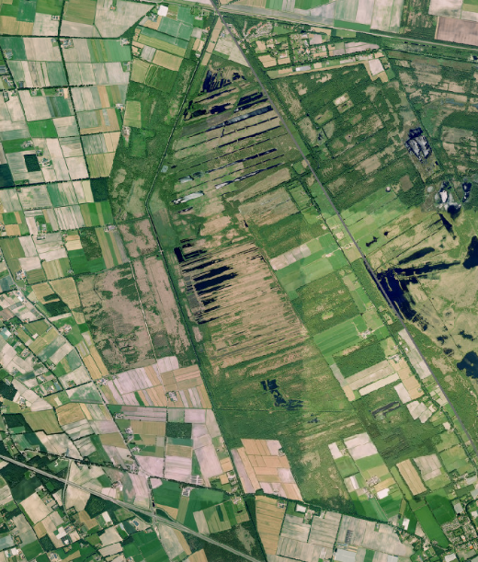
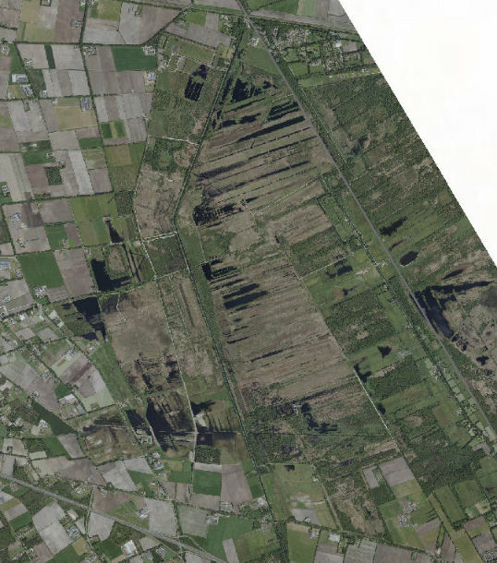
Right on the edge between nature, agriculture and urban
2006
2023

Slide 28
In the future
Despite conservation efforts in the past, much of the Peel is still too dry for a recovering raised bog system.
But what to do next?
Broad zones around the Peel of more extensive agriculture with high groundwater tables? Increase our dependence on irrigation water?
No easy (or cheap) solutions. Nature conservation is not popular with the people in or around the Peel.

Slide 29
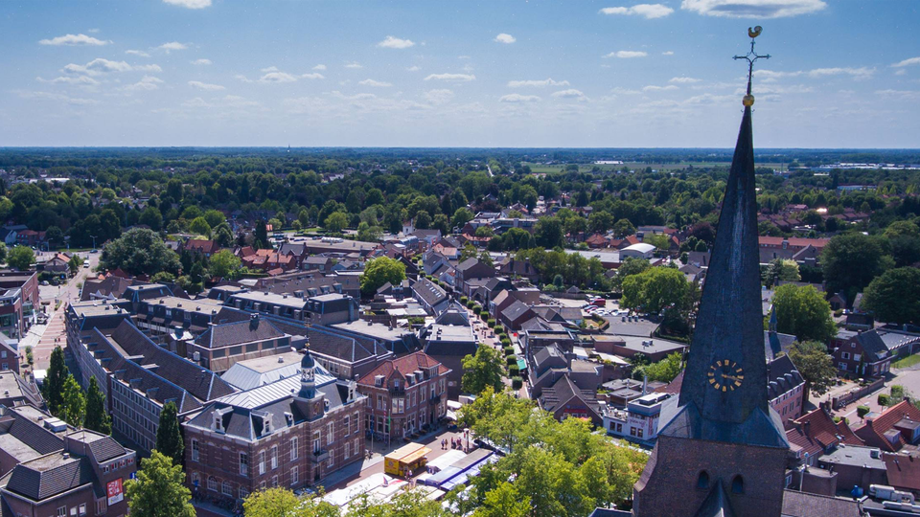
Municipality Deurne

Slide 30
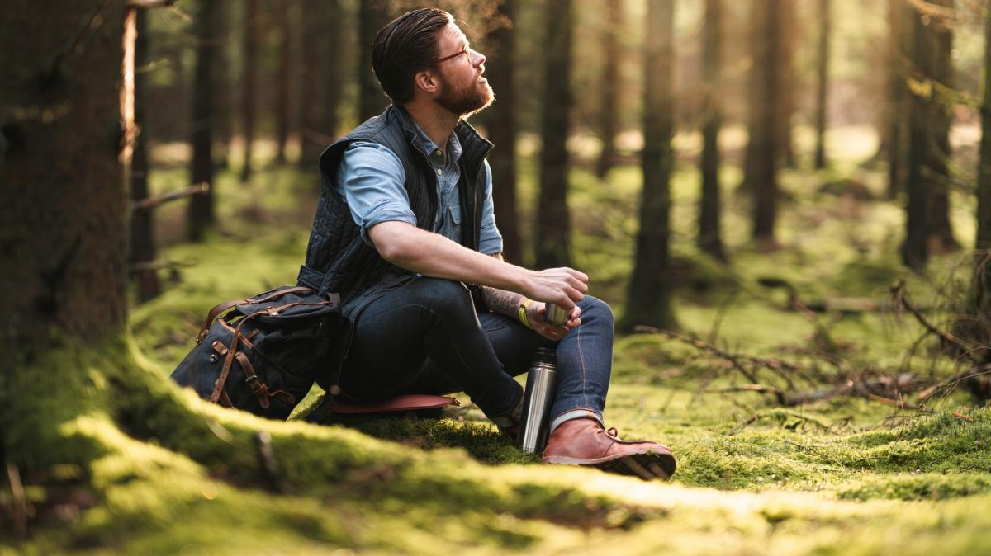
Break
Notes:
Titelpagina variant 1.2 bedoeld als startpagina van je presentatie

Slide 31
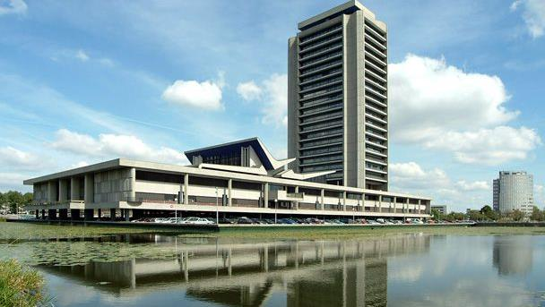
Province Noord-Brabant
Notes:
Titelpagina variant 1.2 bedoeld als startpagina van je presentatie

Slide 32
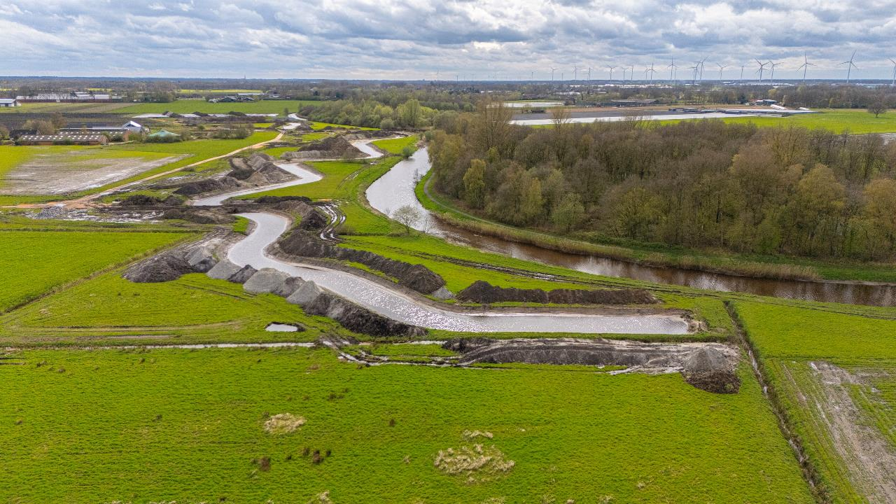
North-Brabant Network of Nature & Finances
June 12, 2025
Picture:
Markdal, near Breda

Slide 33
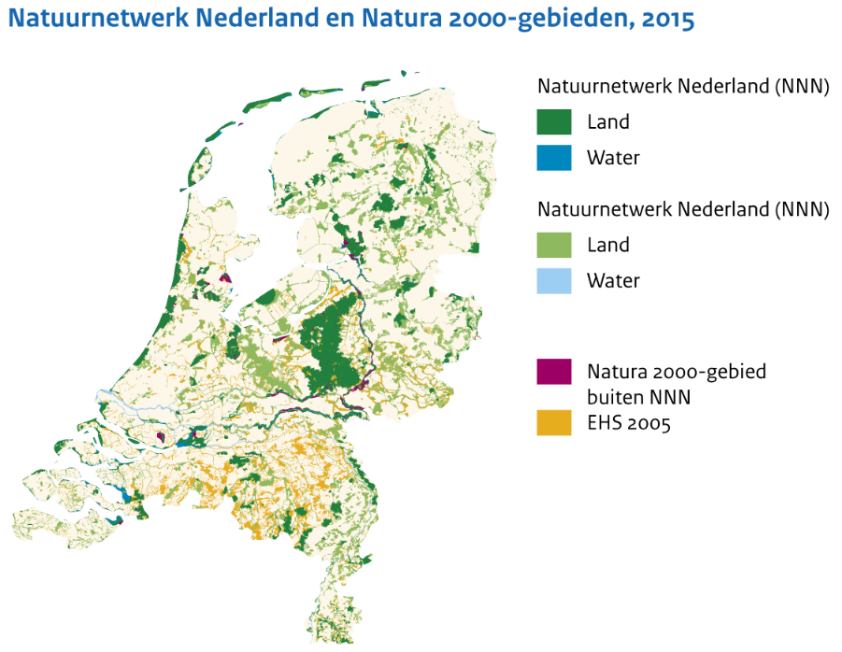
Natuurnetwerk Nederland
Formerly know as the
Main Ecological Structure
Ecologische Hoofdstructuur EHS
Provincial task since 2014
Notice the orange

Slide 34
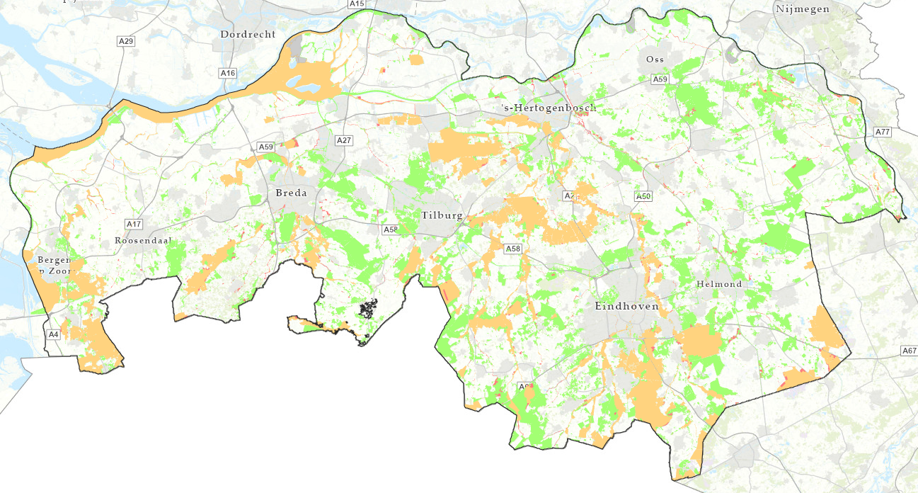
Natuurnetwerk Brabant (NNN)
Natuurnetwerk Brabant
Natuurnetwerk Nederland
Natuurnetwerk Brabant (NNB)
North-Brabant Network of Nature

Slide 35
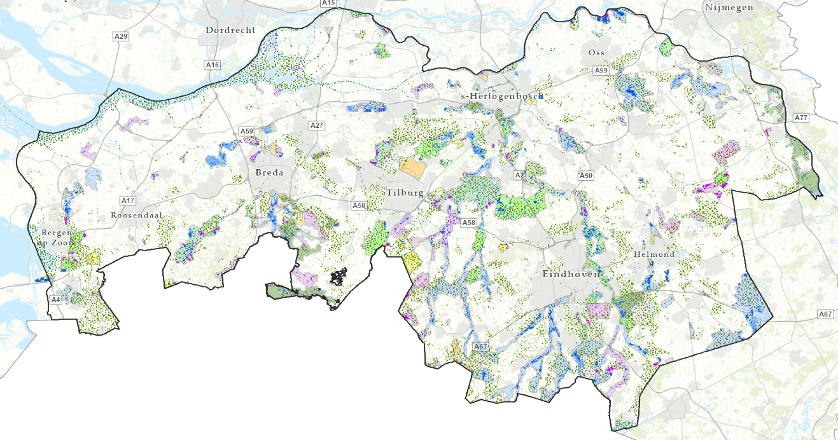
Natuurnetwerk Brabant (NNN)
Partners
Natuurnetwerk Nederland
Natuurnetwerk Brabant (NNB)
North-Brabant Network of Nature

Slide 36
Finances
Overview
Verwervings- en inrichtingssubsidie > Subsidies for Acquirement and Establishment
Beheersubsidie > Subsidy for Maintenance and Preservation
And also several grants, like:
SPUK, Stila, LPN, no-regret middelen & natuurcompensatiemiddelen and several European grants.

Slide 37
Finances
€€€
Subsidies for Acquirement Subsidy for Maintenance
and Establishment and Preservation

Slide 38
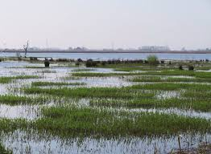
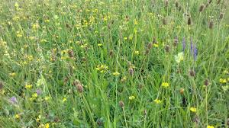
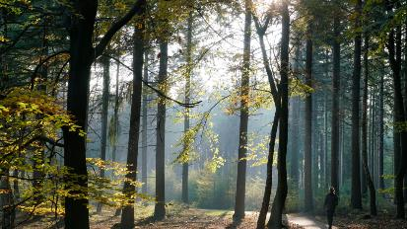
Finances
Actual costs
1 hectare = € 125.000,- in total to acquire and establish
Dynamic swamp Diverse grassland Mixed forest
+/- € 600/ha +/- € 330/ha +/- € 160/ha

Slide 39

Any questions??

Slide 40
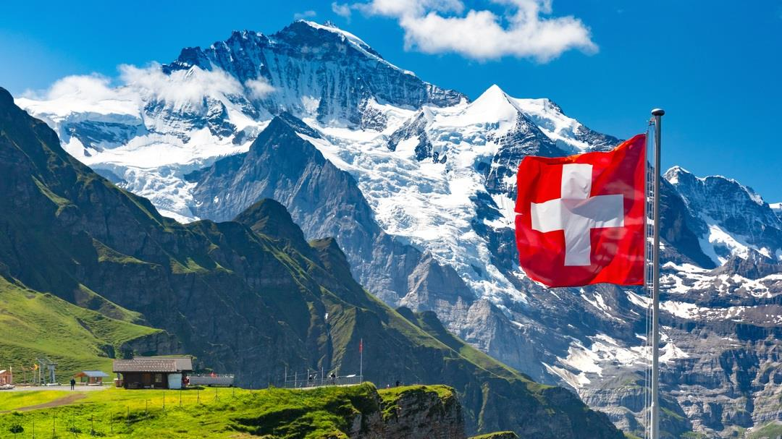
Naturschutz Zürich
Notes:
Titelpagina variant 1.2 bedoeld als startpagina van je presentatie

Slide 41
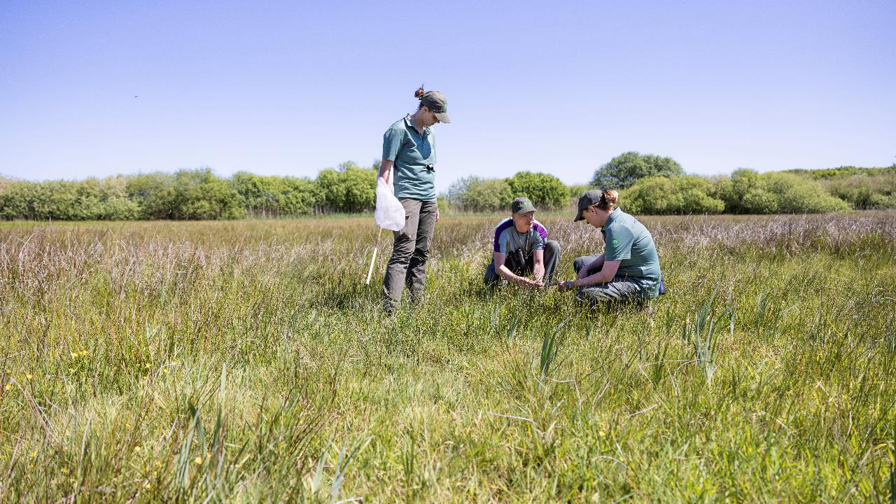
Let’s talk!
Notes:
Titelpagina variant 1.2 bedoeld als startpagina van je presentatie

Slide 42
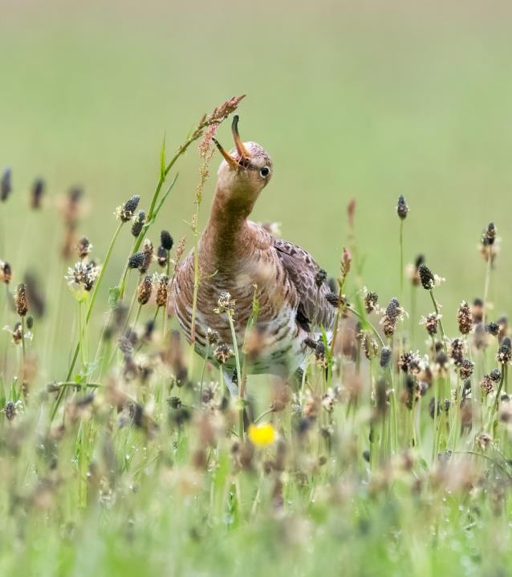
Lunch
12.00 - 13.00

